Slide 1


A Specimen-based View of the World
Using the Biological Collections Ontology to Model Biodiversity Collections
ICBO 2014, Houston, Texas, USA
Ramona Walls
Robert Guralnick
John Deck
Andréa Matsunaga

Slide 2
The biodiversity standards landscape
ECOLOGY
field surveys
observations
environments
MUSEUM COLLECTIONS
specimens
checklists
GENOMICS
molecules
specimens

Slide 3
Understanding biodiversity requires us to work at the intersection of disciplines
ECOLOGY
MUSEUM COLLECTIONS
GENOMICS

Slide 4
Existing standards for biodiversity
Darwin Core (DwC)
Minimum Information for any (x) Sequence (MIxS)
Extensible Observation Ontology (OBO-E) and the Observation and Measurements (O&M)standard

Slide 5
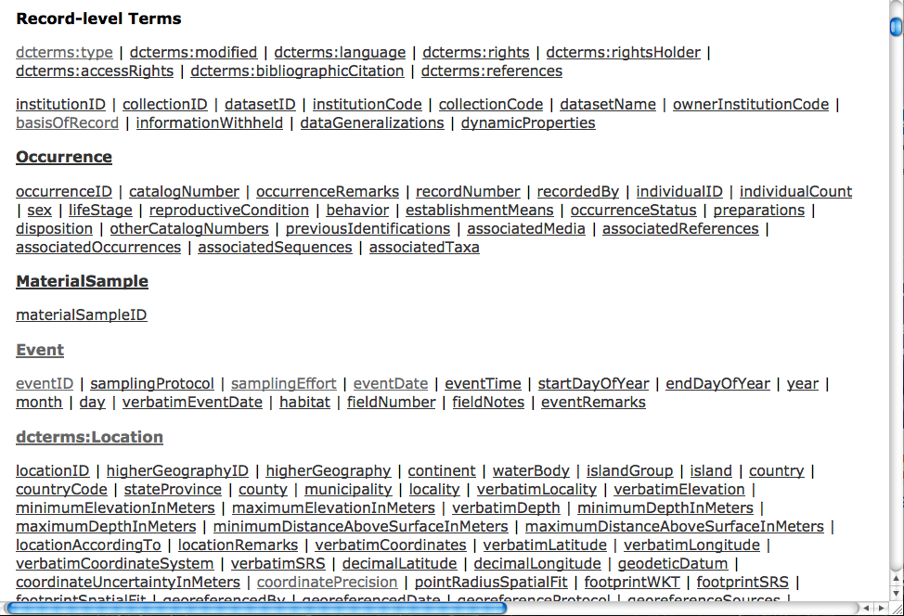

Slide 6
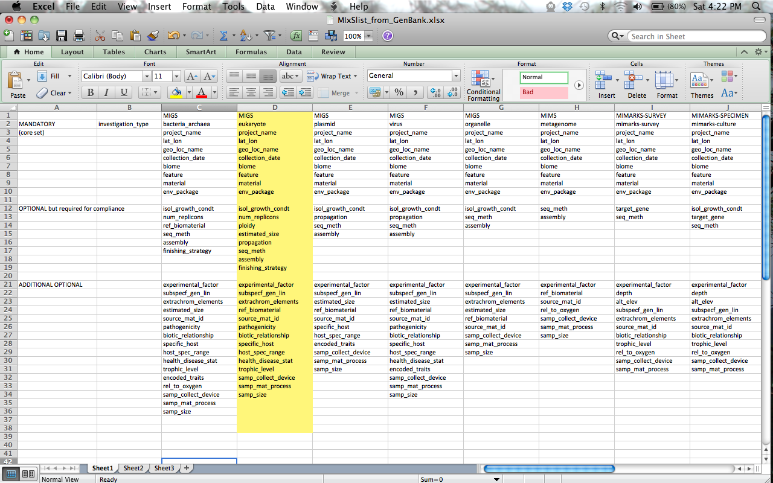
Minimum Information for any (x) Sequence (MIxS)

Slide 7
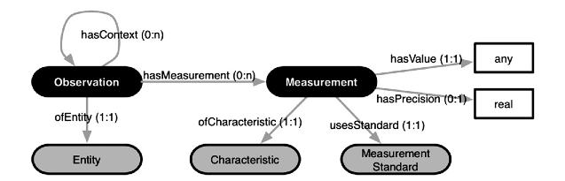
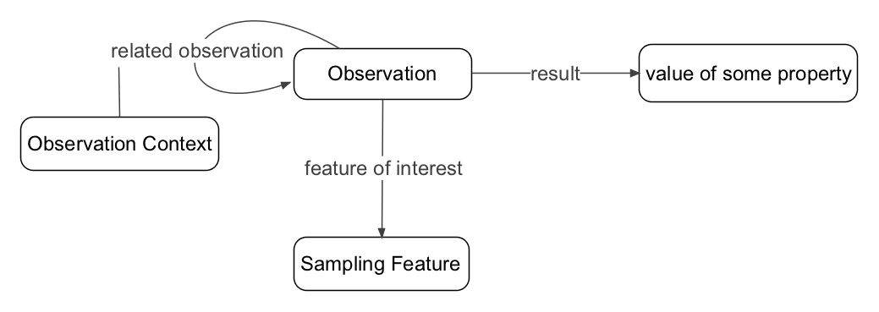
Extensible Ontology for Observations (OBO-E) is an ontology that is consistent with the Observation and Measurement (O&M) schema
OBO-E:
Madin et al. 2007 Ecol. Informatics doi: 10.1016/j.ecoinf.2007.05.004
O&M:

Slide 8
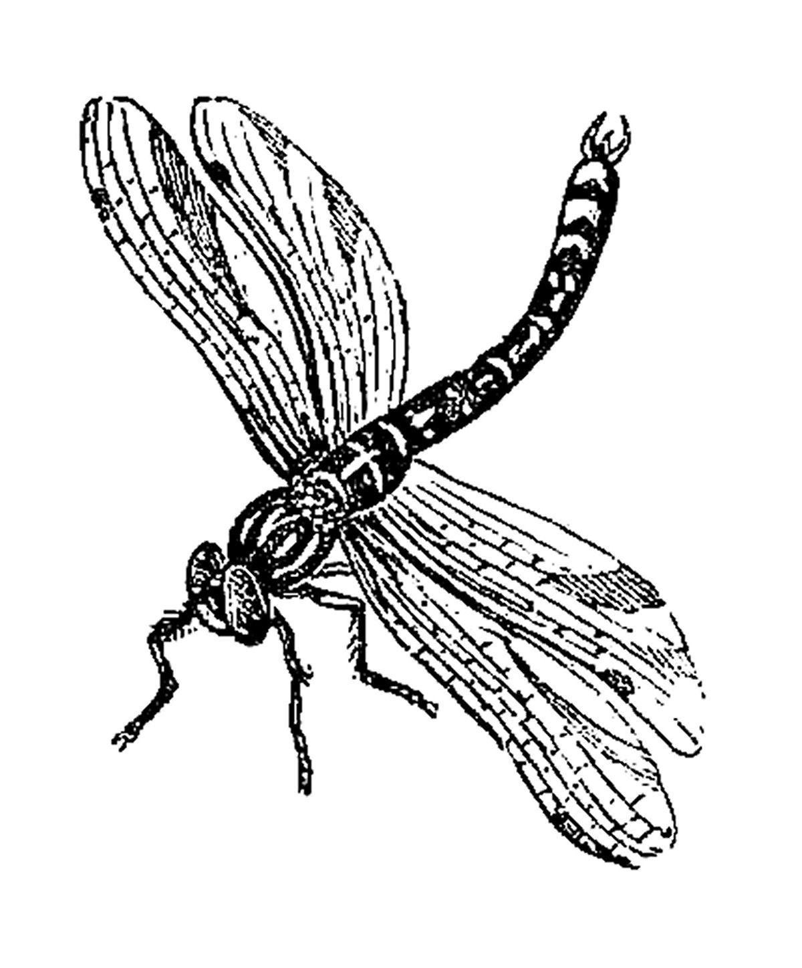
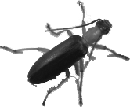
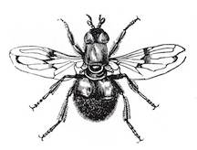
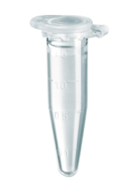

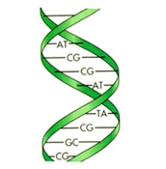
BCO use case: tracking specimens across repositories and data types
Digital image stored on Morphbank
Museum specimens
Identification
Genbank sequence
Tissue sample at
Smithsonian Institution
Moorea Biocode
bioinventory event
Gut sample
Metagenomic sequences
at CAMERA portal

Slide 9
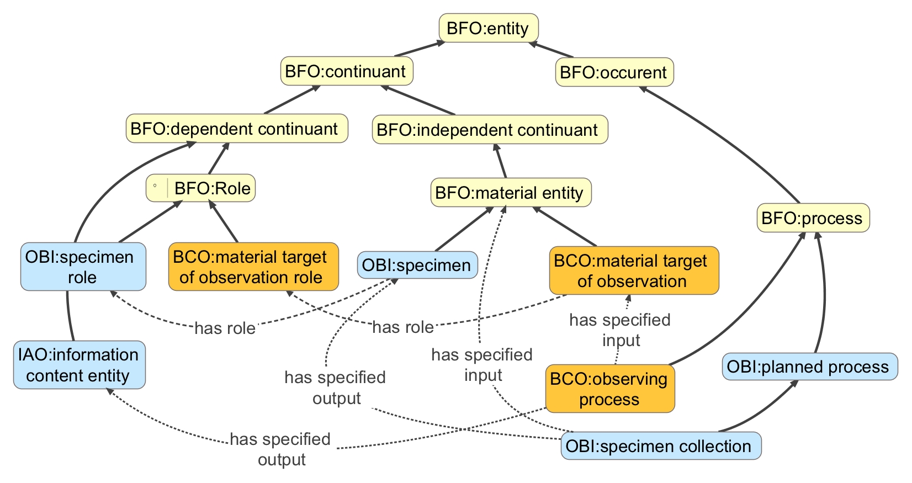
Key BCO upper-level classes
subclassOf

Slide 10
derives from by planned process:
is_specified_input_of o 'has output' subPropertyOf ‘derives from by planned process’
is derived into by planned process:
is_specified_output_of o 'has input' subPropertyOf ‘is derived into by planned process’

Slide 11
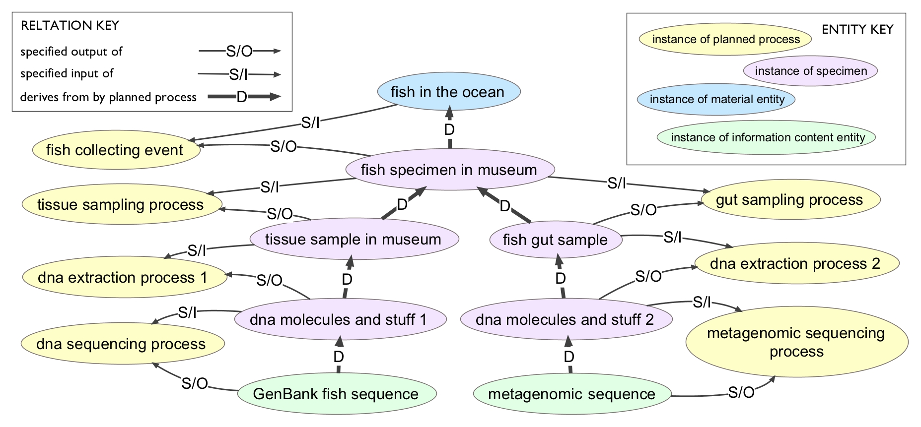

Slide 12
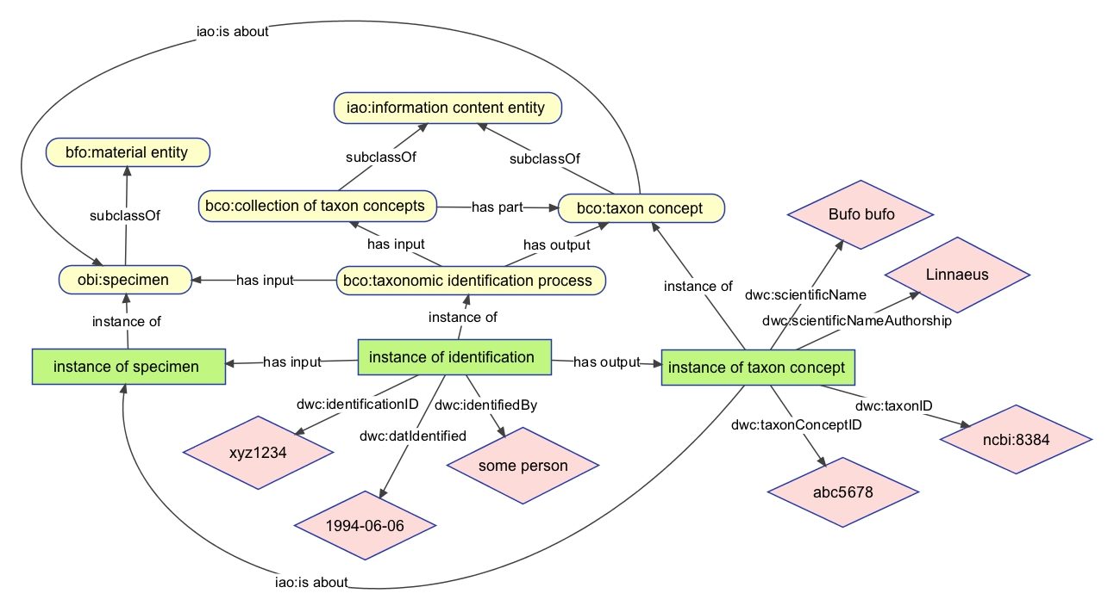
Using Darwin Core properties in BCO

Slide 13
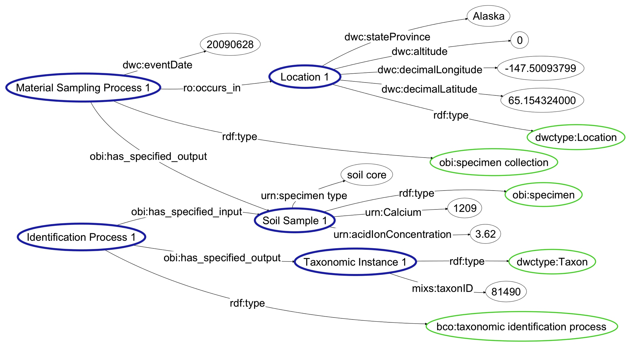
Challenge: getting existing datasets into a form where we can query them the way we want
NEON soil sample data mapped to BCO

Slide 14
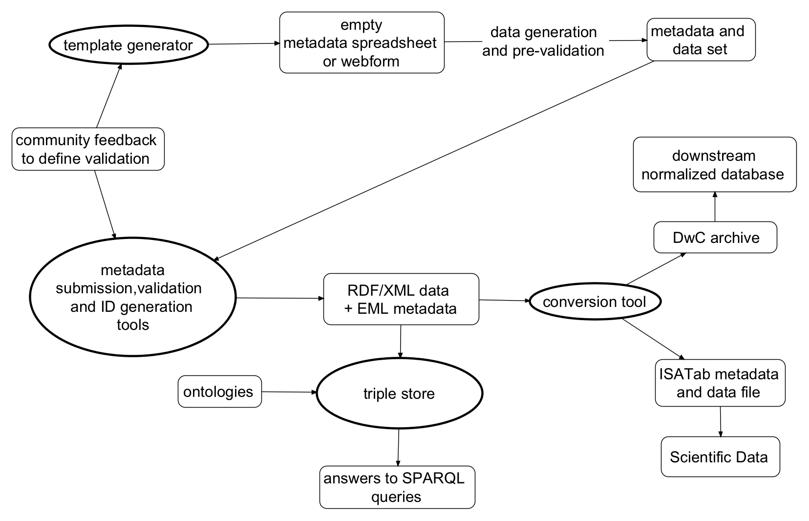
field to repository workflow

Slide 15
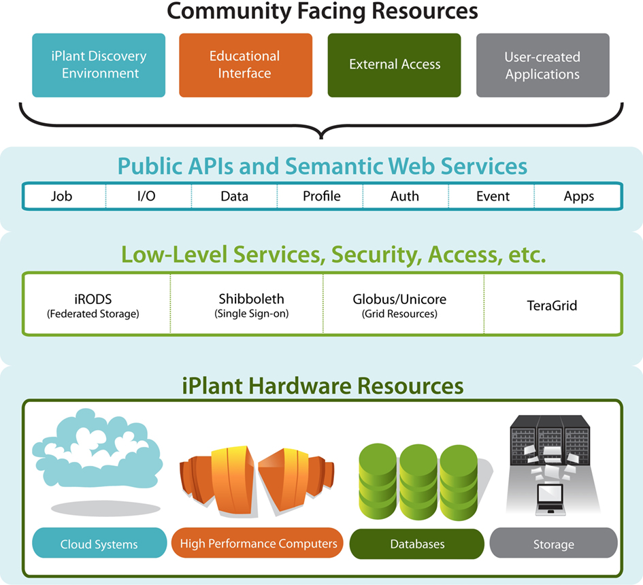

Scaling up: bringing the metagenomic data into the iPlant Data Commons
Bonnie Hurwitz
Ken Youens-Clark
iPlant staff

Slide 16
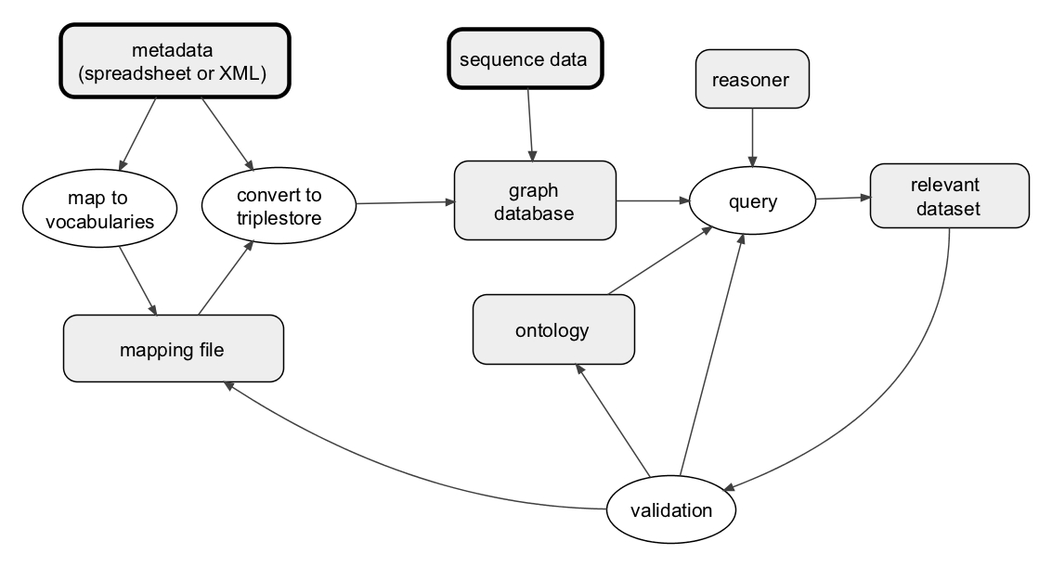
validate workflow with existing data

Slide 17
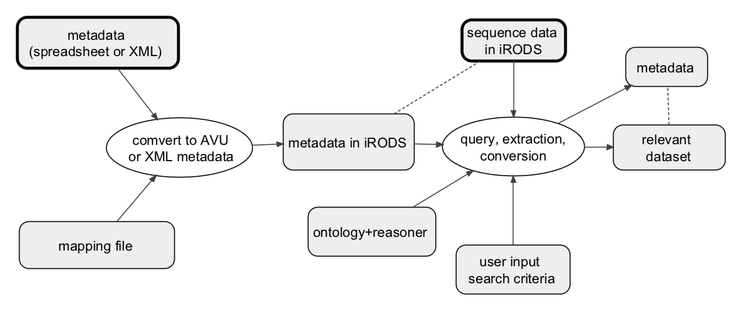
production workflow leveraging iRODS technology
Notes:
Integrated Rule-Oriented Data System (iRODS)

